Slide 1
Handwriting Analysis
Using convolutional neural networks

Slide 2
AGENDA
Objective
CSAFE
Preprocessing
TrOCR
CNN
Result

Slide 3
objective
To develop a Convolutional Neural Network (CNN) capable of determining whether an image of handwriting was produced by a left- or right-handed person. The analysis will include Microsoft’s TrOCR for feature extraction and CNN to classify handwriting into left-handedness or right-handedness.

Slide 4
CSAFE Handwriting database
This work was partially funded by the Center for Statistics and Applications in Forensic Evidence (CSAFE) through Cooperative Agreement #70NANB15H176 between NIST and Iowa State University, which includes activities carried out at Carnegie Mellon University, University of California Irvine, and University of Virginia.
CSAFE Handwriting Database (figshare.com)

Slide 5
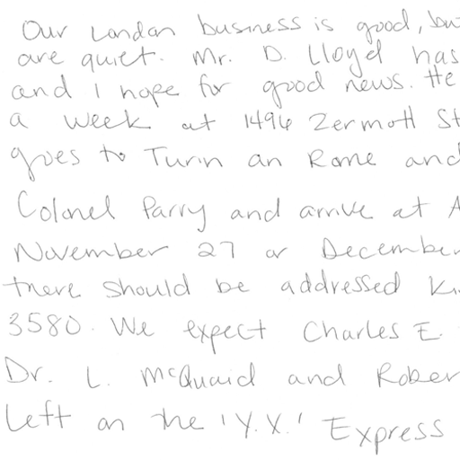
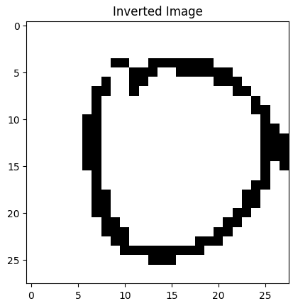
Preprocessing

Slide 6
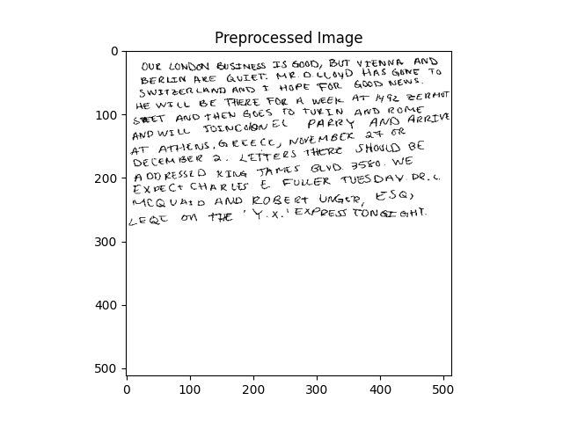
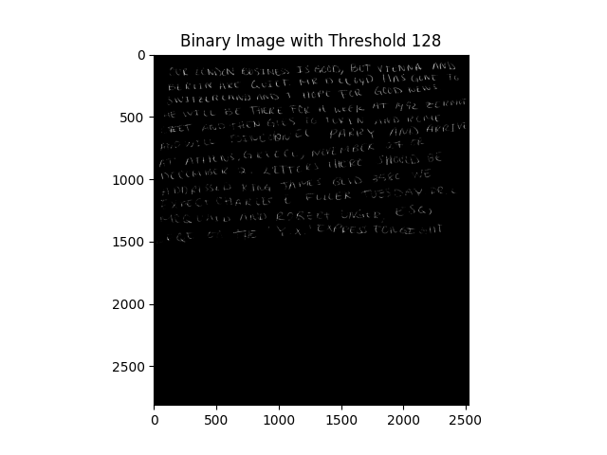

Slide 7
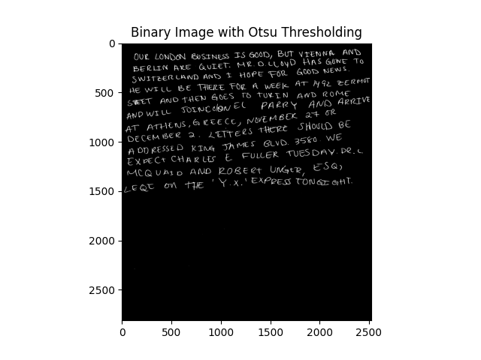
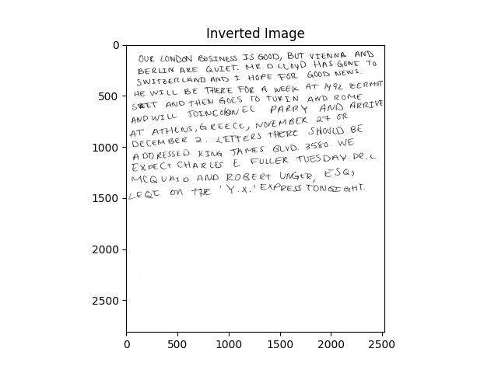

Slide 8
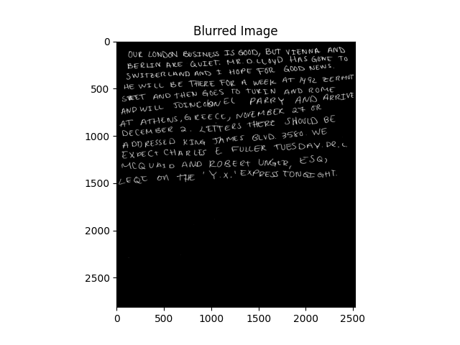


Slide 9
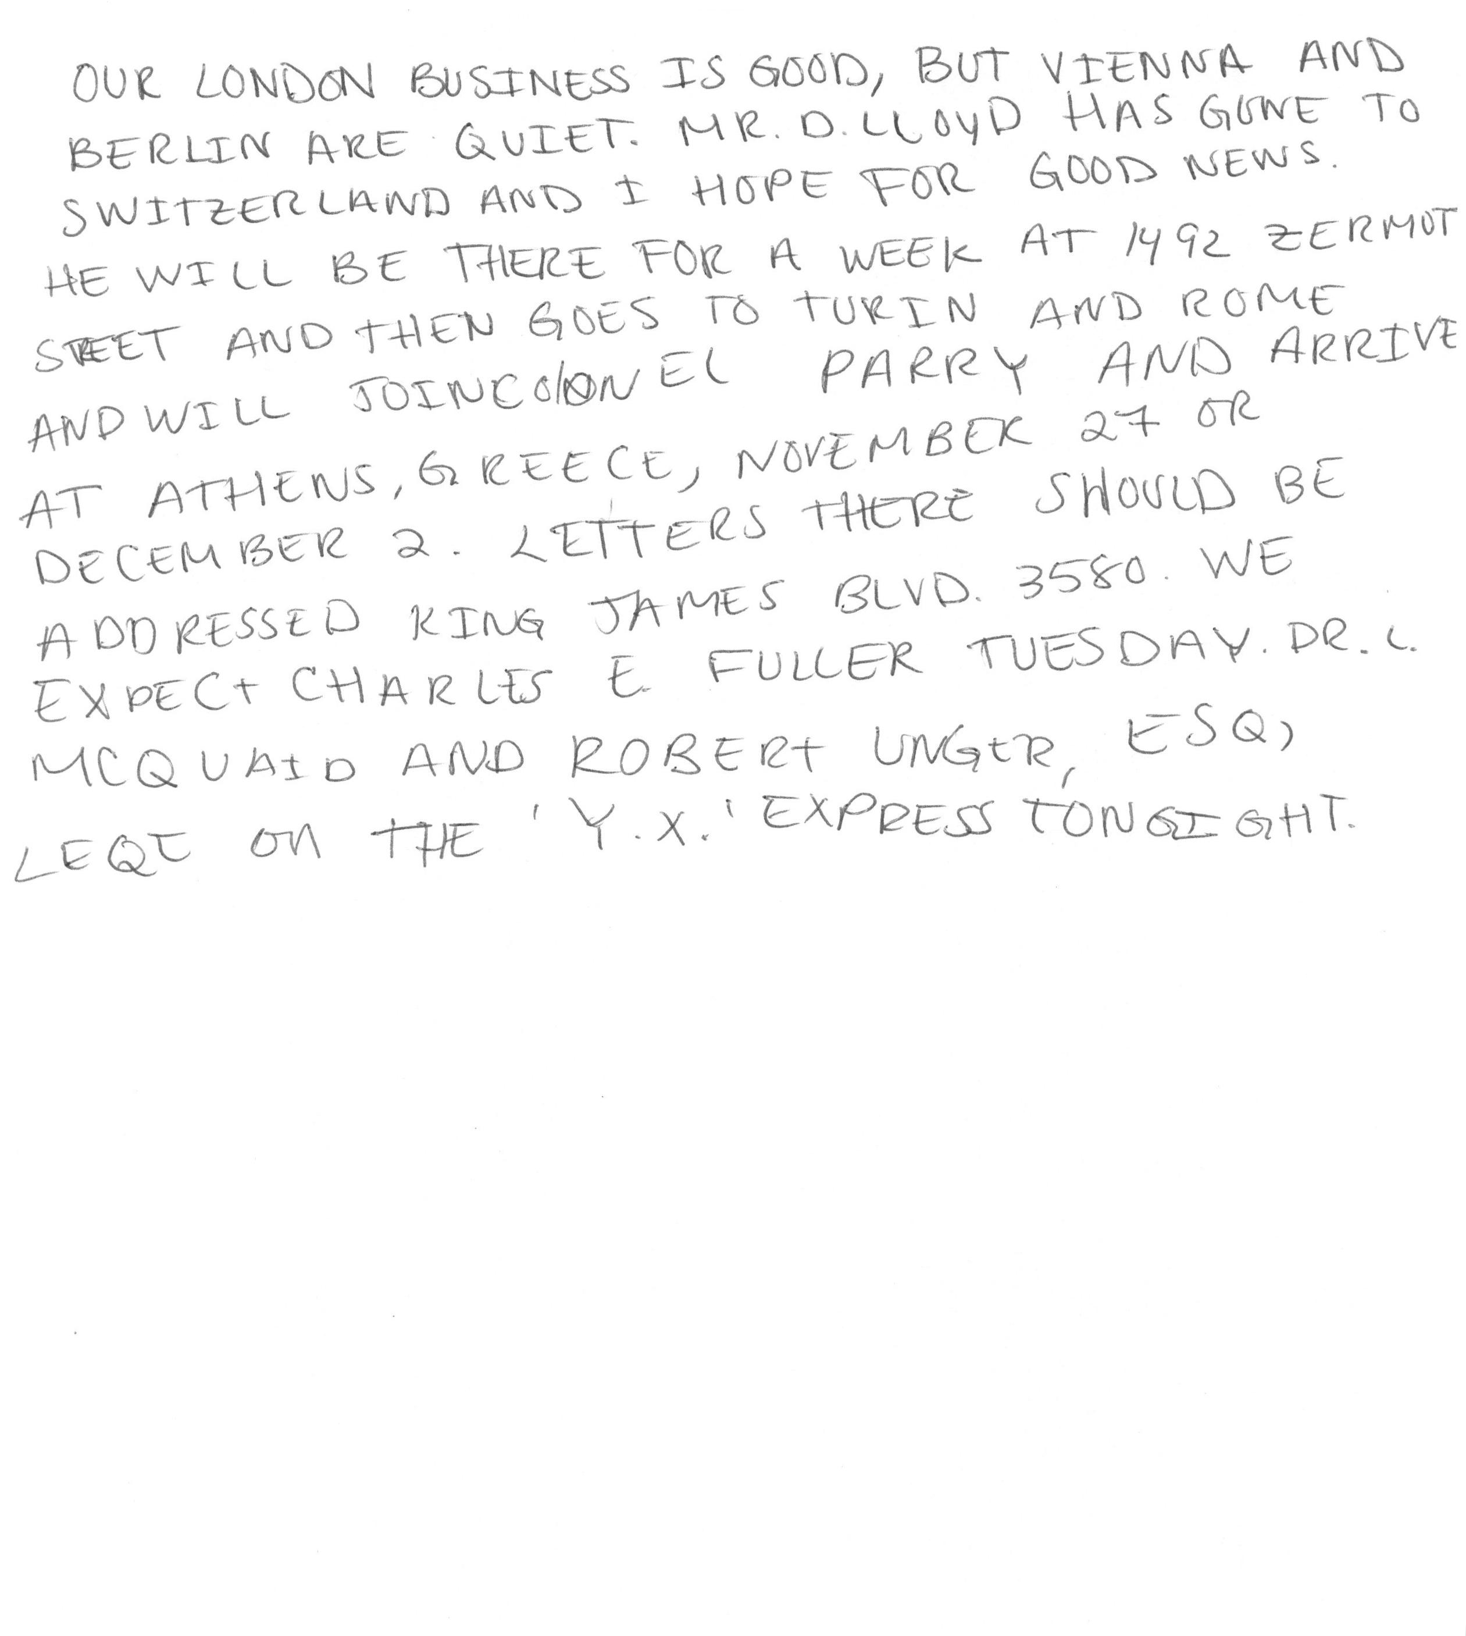
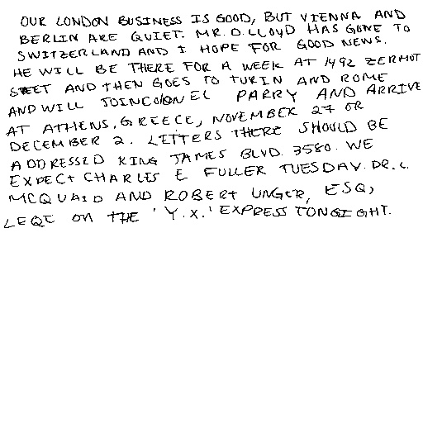
Output

Slide 10
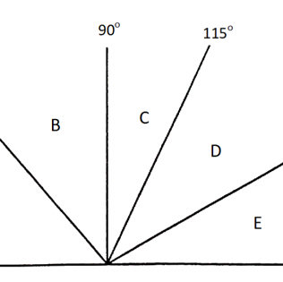
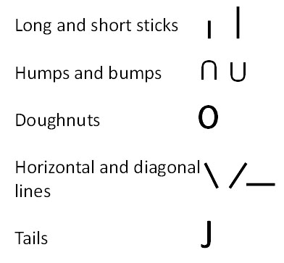
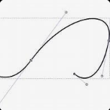
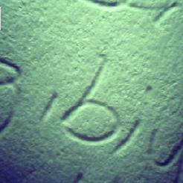
Microsoft’s trocr
Slant of handwriting
Curvature and Smoothness
Pressure distribution
Stroke patterns
Detects handwriting slant by finding edges and lines with OpenCV and calculates the average angle of detected lines.
Analyzes the direction of handwriting strokes by tracing contours and calculates angles between consecutive points of contours.
Calculates curvature for sets of three consecutive contour points using geometric formulas. Smoothness Is measured as the distance between points in a contour.
Measures handwriting pressure by applying Gaussian blur and thresholding on the grayscale image. Calculates the average sum of pixel intensities along rows.
Transformer-based Optical Character Recognition was developed to recognize text or images in scanned documents.

Slide 11
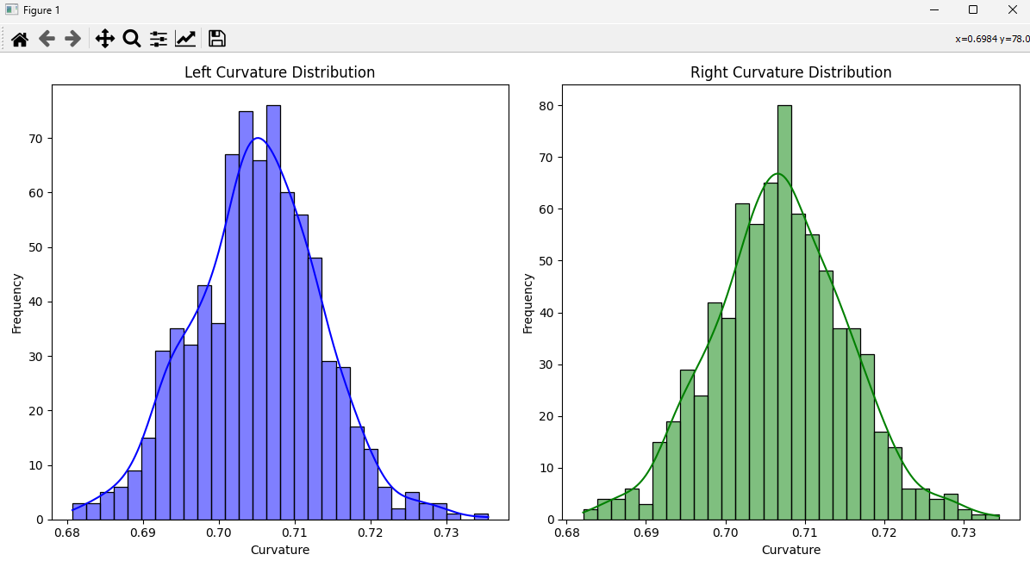
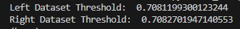
Curvature Classification
This was the feature that had results already closest to 0 and 1. The curvature column was ideal for binary classification. The numbers were either rounded down to 0 for left-handedness or up to 1 for right-handedness.

Slide 12
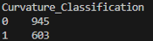
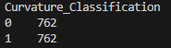
smote
Synthetic minority oversampling technique
Part of the imbalanced_learn library
After curvature_classification 0 – 945 and 1 - 603
Balances by oversampling the minority class with generated synthetic samples
Brings both classes to 762

Slide 13
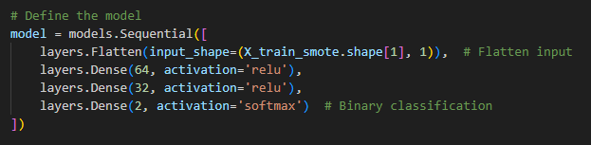
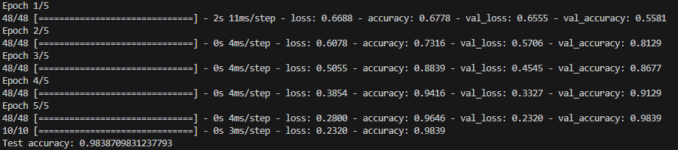
cnn
Model architecture
Result

Slide 14


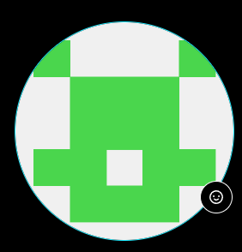




MEET OUR TEAM
Jordan graves
Jeff gary
Toni akande
Paige manguiat
​
​

Slide 15
THANK YOU ☺
Group 2
Jordan Graves, Jeff Gary, Toni Akande, Paige Manguiat
https://github.com/JGraves79/Handwriting_CNN.git
Vanderbilt University Data Analytics Bootcamp

